Slide 1



MARKETING INSIGHT ANALYSIS
02/13/25
By Aisha Hamza (Toroshanty.01)
HNG Task 2

Slide 2

INTRODUCTION
HNG Task 2
02/13/25
In today's competitive digital marketing landscape, data-driven decision-making is essential for maximizing campaign effectiveness. This report presents an in-depth exploratory data analysis (EDA) of a marketing campaign dataset, offering valuable insights to optimize spending and enhance performance.
The analysis focuses on identifying the most effective marketing channels, tracking conversion rates and ROI trends, evaluating customer engagement levels, and uncovering patterns across different target audiences and locations. These insights provide a data-backed foundation for refining strategies, improving cost efficiency, and making informed decisions to drive better campaign outcomes.

Slide 3
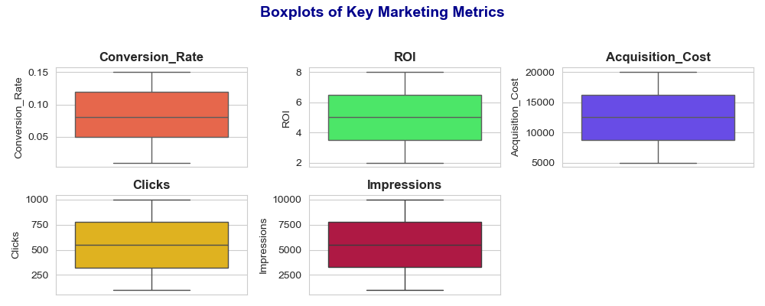
FINDINGS AND INSIGHTS
HNG Task 2
02/13/25
Boxplots analyzed the distribution of key metrics, including Conversion Rate, ROI, Acquisition Cost, Clicks, and Impressions. Outliers in ROI and CPC indicated significant variations, suggesting some campaigns performed exceptionally well or poorly.

Slide 4
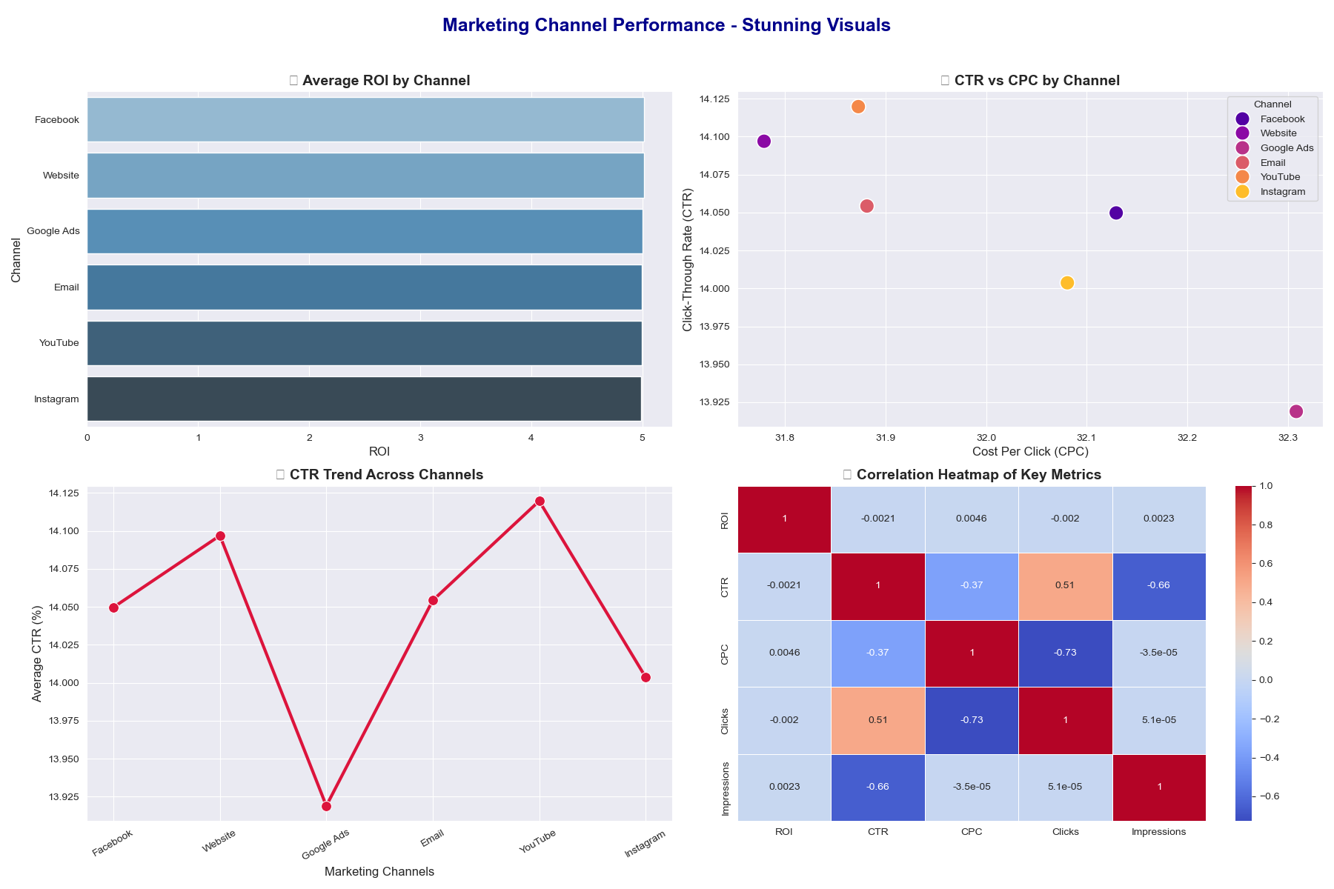
FINDINGS AND INSIGHTS
HNG Task 2
02/13/25
Marketing channel analysis showed that Email and Google Ads were the most cost-effective. A bar chart compared average ROI across channels, while a scatter plot analyzed CTR vs. CPC. A line chart tracked CTR trends over time. The correlation heatmap revealed a positive link between CTR and ROI, while Acquisition Cost had a weaker impact on success.

Slide 5
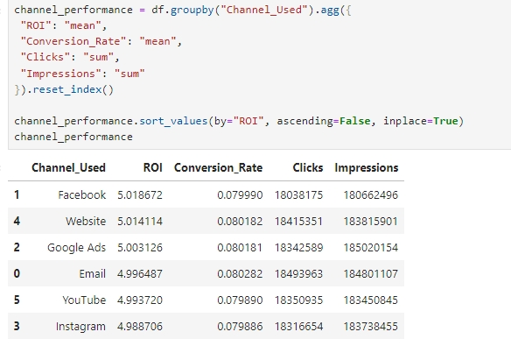
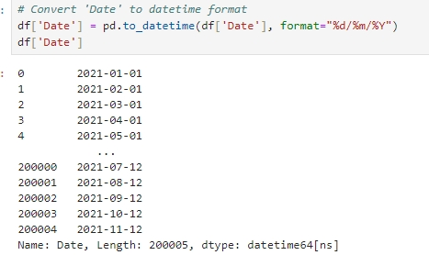
CODE AND METHODOLOGY
HNG Task 2
02/13/25
Cleaning & Preprocessing – Handled missing values, converted data types, and extracted relevant features.
Exploratory Data Analysis (EDA) – Used descriptive statistics and visualizations to identify trends and patterns.
Visualization Techniques – Bar charts, scatter plots, line charts, boxplots, and heatmaps were used to analyze marketing performance.
Correlation Analysis – Examined relationships between key metrics to assess performance drivers.

Slide 6
HNG Task 2
02/13/25
CONCLUSIONS
This analysis highlights top marketing channels, audience segments, and locations for optimization. Facebook and Email had the highest ROI, while Men (25-34) showed the best engagement.
RECOMMENDATIONS
Prioritizing Miami and Los Angeles and optimizing CPC for Google Ads and YouTube can improve cost efficiency. Regular trend monitoring will enhance budget allocation.

